Slide 1
FOR THIRTY YEARS now I have been studying my fellow-men. I do not know very much about them. I should certainly hesitate to engage a servant on his face, and yet I suppose it is on the face that for the most part we judge the persons we meet. We draw our conclusions from the shape of the jaw, the look in the eyes, the contour of the mouth. I wonder if we are more often right than wrong.

Slide 2
Why novels and plays are so often untrue to life is because their authors, perhaps of necessity, make their characters all of a piece. They cannot afford to make them self-contradictory, for then they become incomprehensible, and yet self-contradictory is what most of us are. We are a haphazard bundle of inconsistent qualities.

Slide 3
In books on logic they will tell you that it is absurd to say that yellow is tubular or gratitude heavier than air; but in that mixture of incongruities that makes up the self yellow may very well be a horse and cart and gratitude the middle of next week.

Slide 4
I shrug my shoulders when people tell me that their first impressions of a person are always right. I think they must have small insight or great vanity. For my own part I find that the longer I know people the more they puzzle me: my oldest friends are just those of whom I can say that I don’t know the first thing about them.

Slide 5
One afternoon I was sitting in the lounge of the Grand Hotel. This was before the earthquake and they had leather arm-chairs there. From the windows you had a spacious view of the harbour with its crowded traffic. There were great liners on their way to Vancouver and San Francisco or to Europe by way of Shanghai, Hong-Kong, and Singapore;

Slide 6
there were tramps of all nations, battered and sea-worn, junks with their high sterns and great coloured sails, and innumerable sampans. It was a busy, exhilarating scene, and yet, I know not why, restful to the spirit. Here was romance and it seemed that you had but to stretch out your hand to touch it.

Slide 7
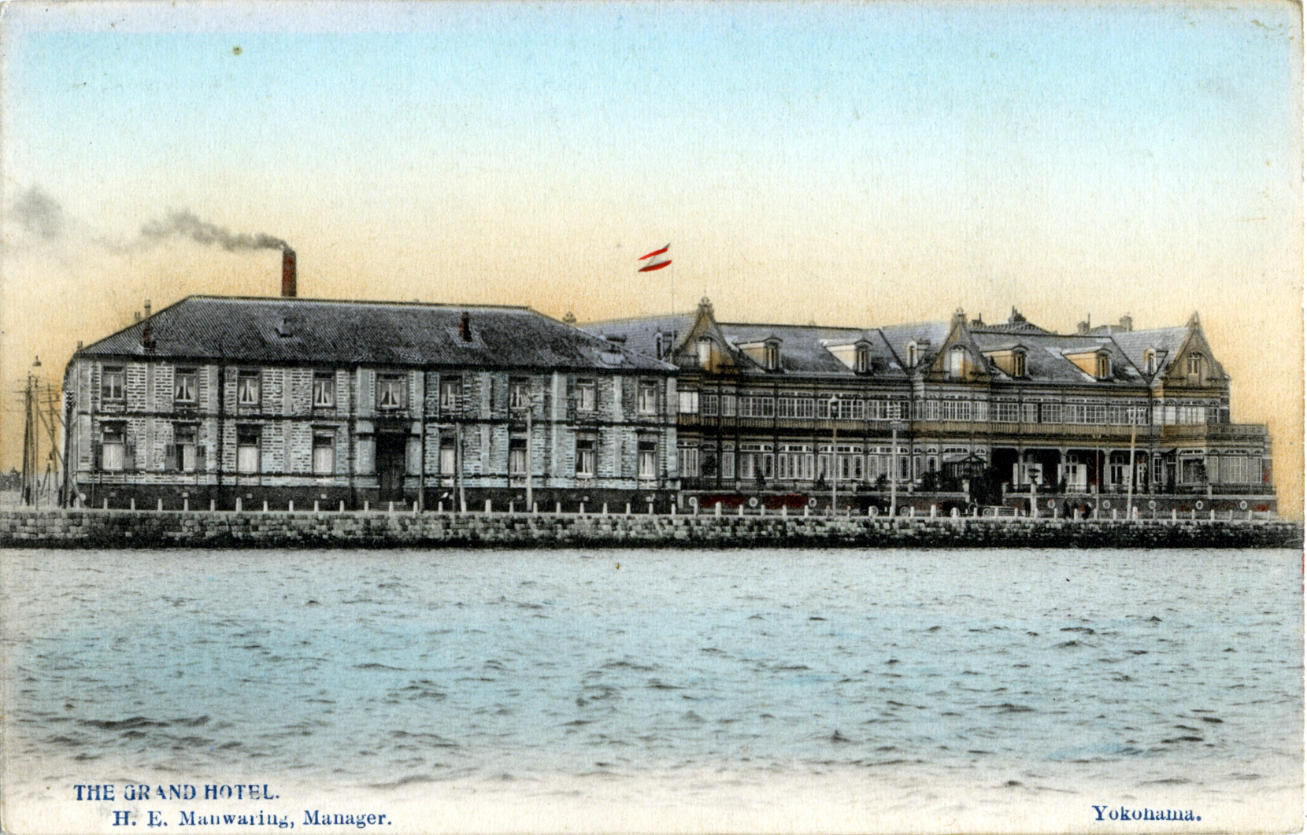

Slide 8
